Slide 1
Programming for Engineers in Python
Spring 2019
Recitation 4: Dictionaries and Debugging

Slide 2
Plan
Reminder: Mutable vs. Immutable
Dictionaries
Examples:
Student to grade mapping
Sparse matrix
Pangrams
Two dice
Debugging code
Methods
Examples
Incorrect use of functions
Reference errors
Anagrams
Advanced dictionaries example: Spell Corrector

Slide 3
Reminder: Mutable vs. Immutable
Mutable:
>>> a_list = [1,2,3]
>>> a_list[2] = 'Inigo Montoya'
>>> a_list
[1, 2, 'Inigo Montoya']
Immutable:
>>> name = 'Inigo Montoya'
>>> name[3] = 't'
Traceback (most recent call last):
File "<pyshell#14>", line 1, in <module>
name[3] = 't'
TypeError: 'str' object does not support item assignment

Slide 4
Reminder: Tuples
A tuple is just like a list, only it is immutable.
Syntax: note the parentheses!
>>> t = ('physics', 'chemistry', 1997, 2000)
>>> t
('physics', 'chemistry', 1997, 2000)
>>> t[0] # indexing
'physics'
>>> t[-1] # backwards indexing
2000
>>> t[1:3] # slicing
('chemistry', 1997)

Slide 5
Tuples
A tuple is just like a list, only it is immutable.
>>> lst = ['physics', 'chemistry', 1997, 2000]
>>> t = ('physics', 'chemistry', 1997, 2000)
>>> lst[0] = 'math'
>>> lst
['math', 'chemistry', 1997, 2000]
>>> t[0] = 'math'
Traceback (most recent call last):
File "<pyshell#2>", line 1, in <module>
t[0] = 'math'
TypeError: 'tuple' object does not support item assignment

Slide 6
Dictionary
A dictionary maps keys to values.
Keys aren’t necessarily of the same type, and so are values.
# Empty dictionary >>> tel = {} # Define a new dictionary >>> tel = {'jack': 4098, 'sape': 4139}
-keys-
-values-
'jack'
4098
'sape'
4139

Slide 7
Dictionary example
>>> tel = {'jack': 4098, 'sape': 4139}
# Add (or replace) a pair
>>> tel['guido'] = 4127
>>> tel
{'jack': 4098, 'sape': 4139, 'guido': 4127}
# What is the value of the key 'jack'?
>>> tel['jack']
4098
>>> tel['abby']
Traceback (most recent call last): File "<pyshell#23>", line 1, in <module> tel['abby'] KeyError: 'abby'

Slide 8
What can be used as a key?
Immutable types only!
Strings
Numbers
Booleans
Tuples
But remember…
If a tuple contains ANY mutable objects (either directly or indirectly), it cannot be used as a key
>>> a = {} >>> a[(1,2,3,[1,2])] = "wrong"
Traceback (most recent call last): File "<pyshell#35>", line 1, in <module> a[(1,2,3,[1,2])]="wrong" TypeError: unhashable type: 'list'

Slide 9

Some dictionary methods
Description | Method
Returns dict[k] if dict has the key k, otherwise d (default: d=None) | dict.get(k, [d])
The same as with lists, strings, tuples… Returns True if dict has a key k, otherwise False | k in dict
Removes from dict the specified (key, value) pair with key k, and returns its value. If k is not in dict, returns d. If d is not given and k is not in dict, an error is raised | dict.pop(k, [d])
* Arguments in square brackets are optional

Slide 10
Some dictionary methods
Description | Method
Iterable view of dict's keys in arbitrary order | dict.keys()
Iterable view of dict's values in arbitrary order | dict.values()
Iterable view of dict's (key, value) pairs in arbitrary order | dict.items()
Updates dict with the (key, value) pairs from other (another dictionary object or an iterable of (key, value) pairs). Returns None. | dict.update([other])
Creates a shallow copy of dict (constructs a new dictionary, and inserts references to the original keys/values) | dict.copy()
Reminder: a view gives us access to stored values. It is not a new object.
We can create list of keys/values/items using the list function.
For example: list(D.values()) creates a new list with D’s values.
sorted (dict.keys() / dict.values() / dict.items()) create a sorted list.
Notes:
Explanation of a shallow copy :
>>> D = {"a": [0,1], "b":[2,3]}
>>> D1 = D.copy()
>>> D["c"] = [4,5]
>>> D1["a"].append(15)
>>> D
{'a': [0, 1, 15], 'c': [4, 5], 'b': [2, 3]}
>>> D1
{'a': [0, 1, 15], 'b': [2, 3]}

Slide 11
Dictionary methods example
{'sape': 4139, 'jack': 4098, 'guido': 4127}
# delete an entry
>>> tel.pop('sape')
4139
# get the keys - returns a list, order is arbitrary
>>> tel.keys() dict_keys(['jack', 'guido'])
# check if a key is in tel
>>> 'guido' in tel True
If the key ('jack') is not in the dictionary (tel), then by default, get() returns None
# Get value of a key
>>> tel.get('jack')
4098
>>> tel.get('sape', 'Missing')
'Missing'
If you specify a second argument, get() returns it if the key ('sape') is not in the dictionary (tel)

Slide 12
Keys Order is Arbitrary
>>> a = {}
>>> for i in range(10): a[str(i)] = i
>>> a
{'0': 0, '1': 1, '2': 2, '3': 3, '4': 4, '5': 5, '6': 6, '7': 7, '8': 8, '9': 9}
>>> a.keys()
dict_keys(['0', '1', '2', '3', '4', '5', '6', '7', '8', '9'])
>>> a.values()
dict_values([0, 1, 2, 3, 4, 5, 6, 7, 8, 9])

Slide 13
Other methods: dict(), update()
# Input: a list of pairs (list/tuples)
>>> dict([('sape', 4139), ('guido', 4127), ('jack', 4098)])
{'sape': 4139, 'guido': 4127, 'jack': 4098}
# Update: add dict2 to dict1
>>> dict1 = {'Name': 'Zara', 'Age': 7}
>>> dict2 = {'Gender': 'female'}
>>> dict1.update(dict2)
>>> dict1
{'Name': 'Zara', 'Age': 7, 'Gender': 'female'}

Slide 14
Iterating over dictionaries
tel = {'sape':4139, 'jack':4098, 'guido': 4127}
Similar output (but in arbitrary orders!) will be printed in all three cases:
for key in tel:
print(tel[key])
for key in tel.keys():
print(tel[key])
for key, val in tel.items():
print(val)
Iterates through the actual keys (in the memory)
Creates a 'dict_keys’ view, and iterates through the keys dict_keys(['sape', 'jack', 'guido'])
Creates a 'dict_items’ view of (key,value) tuples and iterates through them
dict_items([('sape', 4139), ('jack', 4098), ('guido', 4127)])
Output (order may differ):
4139
4098
4127

Slide 15
Example 1
You are given a nested list of student names and grades. >>> students = [["arya",87], ["jon",88], ["bran",100]]
Given a name we want to know the grade. >>> get_grade(students, "arya") 87
Demands some initial effort
# using a list def get_grade(students, name): for stud in students: if stud[0]==name: return stud[1]
# using a dictionary >>> students_dict = dict(students) >>> students_dict {'arya': 87, 'jon': 88, 'bran': 100}
>>> students_dict.get('arya')
But getting the grade (value) is very fast!
Using a dict for mapping is more straightforward than using a list.
Every lookup of a grade will be typically faster with a dict, since it saves the need to iterate through the names.

Slide 16

Example 2: sparse matrix
In this matrix there are only 3 non-zero entries.
Saving all zeros in a list is a waste of space.
As a dict: A key is a tuple indicating the row-column pair (i,j) whereas a value is the non-zero entry.
>>> matrix = [ [0, 0, 0, 1, 0], [0, 0, 0, 0, 0], [0, 2, 0, 0, 0], [0, 0, 0, 0, 0], [0, 0, 0, 3, 0]]
>>> matrix[1][2]
0
>>> matrix[0][3]
1
>>> matrix = {(0, 3): 1, (2, 1): 2, (4, 3): 3}
>>> matrix.get((1,2),0)
0
>>> matrix.get((0,3),0)
1

Slide 17
Example 3: pangrams
A pangram is a sentence that contains each letter of the English alphabet at least once.
Because the English alphabet has only 26 letters, we could also solve this with a list, initialized as: [False] * 26
However, if the alphabet had 10,000 letters … dict would certainly be better.
def is_pangram(s):
d = {}
for char in s:
if char.isalpha():
d[char.lower()] = True
return len(d) == 26
>>> s = "The quick brown fox jumps over the lazy dog" >>> print(is_pangram(s)) True
>>> s = "The quick brown jumps over the lazy dog" >>> print(is_pangram(s)) False

Slide 18
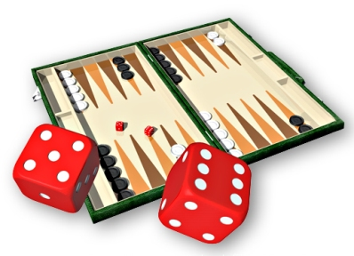
Example 4 – Two Dice
Rolling two backgammon dice yield 36 possible combinations.
We would like to know, for every possible sum of the two dice, the combinations that yield it and their fraction.
Therefore:
Collect all the combinations for every possible sum.
Find the probability of getting each sum.

Slide 19
Example 4 – Two Dice – Cont.
Create the following data structure:
Each combination of two dice is a tuple.
All combinations are held in a dict, where the key is the sum of the combination.
Each value in the dictionary is a list of tuples – that is, all combinations that sum to key.
Keys
Values
2
[ (1 , 1) ]
3
[ (1 , 2) , (2, 1) ]
4
[ (1 , 3) , (2 , 2) , (3 , 1) ]

Slide 20
Example 4 – Two Dice – Cont.
General outline:
Generate dictionary.
For each key: print key, length of its list.
Pseudo-code
rolls = {}
Loop with d1 from 1 to 6:
Loop with d2 from 1 to 6:
key ← d1 + d2
newTuple ← (d1, d2)
oldList ← dictionary value for key
newList ← oldList + newTuple
update: dictionary[key] ← newList

Slide 21
Example 4 – Two Dice – Code
rolls = {}
for dice1 in range(1, 7): # first dice
for dice2 in range(1, 7): # second dice
dices = (dice1, dice2)
dices_sum = dice1 + dice2
if dices_sum in rolls:
combinations = rolls.get(dices_sum)
else:
combinations = []
combinations.append(dices)
rolls[dices_sum] = combinations
for dices_sum, combinations in rolls.items():
print(dices_sum,"\t",len(combinations)/36)
Note that we do not actually need the tuples themselves, only the length of the list. How could we simplify the code ?

Slide 22
Example 4: Dice – Results
Sum
Probability
2 0.0277777777778
3 0.0555555555556
4 0.0833333333333
5 0.111111111111
6 0.138888888889
7 0.166666666667
8 0.138888888889
9 0.111111111111
10 0.0833333333333
11 0.0555555555556
12 0.0277777777778

Slide 23
Plan
Reminder: Mutable vs. Immutable
Dictionaries
Examples
Student to grade mapping
Sparse matrix
Pangrams
Two dice
Debugging code
Methods
Examples
Incorrect use of functions
Reference errors
Anagrams
Advanced dictionaries example: Spell Corrector

Slide 24
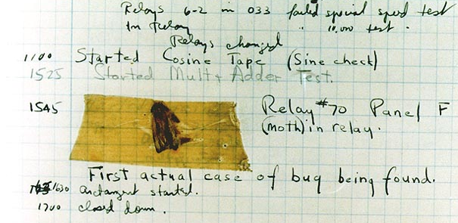
What are “bugs”?
A software bug is an error, flaw, mistake, or failure in a computer program.
Causes unexpected results
Source: Wikipedia

Slide 25
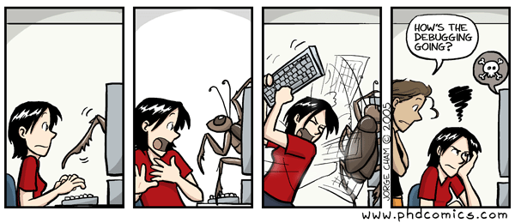
How to Find & Fix Bugs
Finding & fixing bugs is hard and can take a while
Think
Write unit tests
Investigate variables (shell, debugger)

Slide 26

How to Find & Fix Bugs
General Scheme:
Think
Write unit tests
Investigate variables
shell, debugger
Or
Add “print” statements inside functions
Tip: Reduce the problem – less loop iterations, toy data structures, isolate parts of the code, etc.
Runs faster, helps tracing problems.

Slide 27
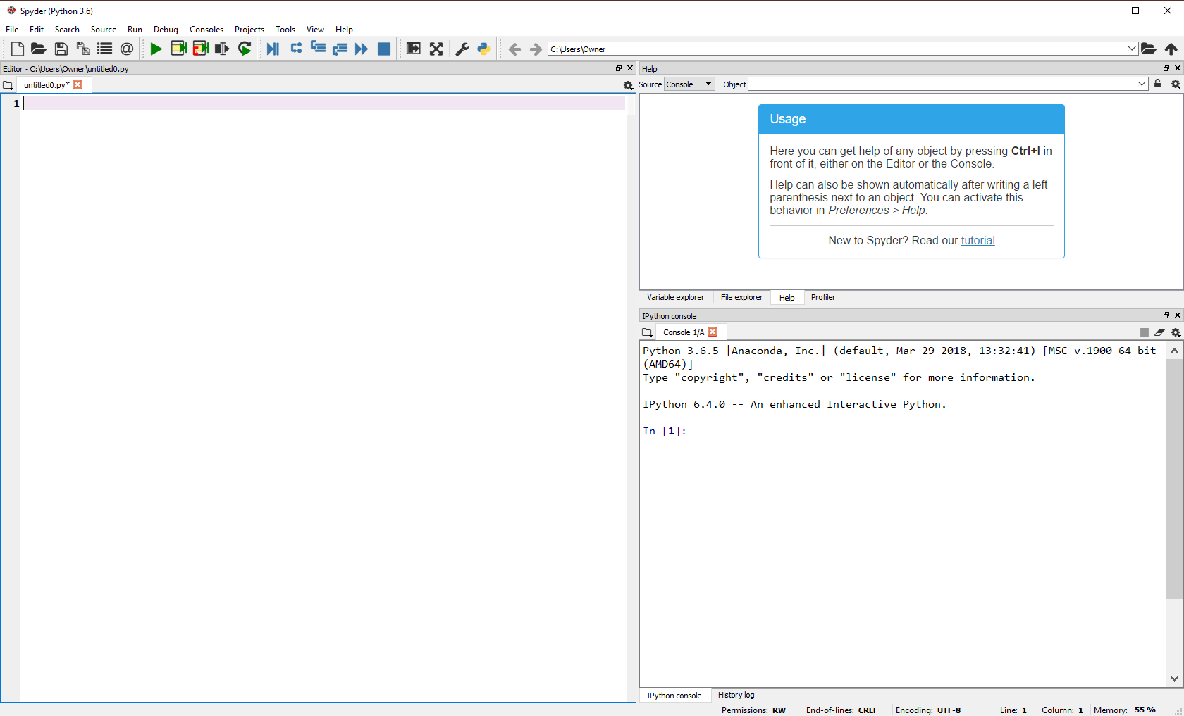
Spyder (packaged with Anaconda)

Slide 28

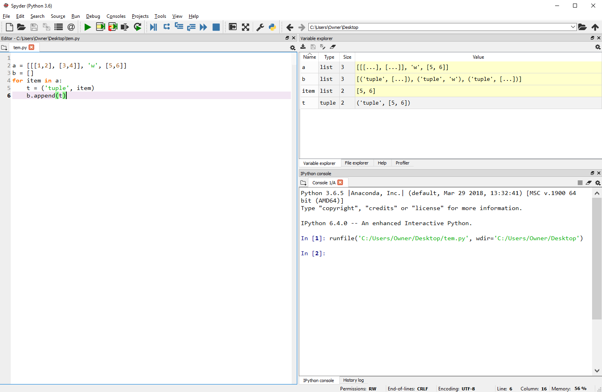
Debugging in Spyder
Start debugging
Variable explorer
Editor
Console (like idle shell)

Slide 29
Stepping inside code
Run next line
Variable values

Slide 30
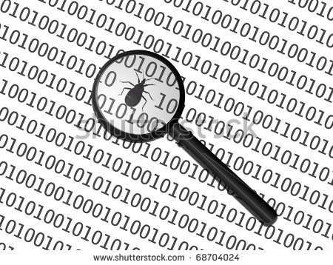
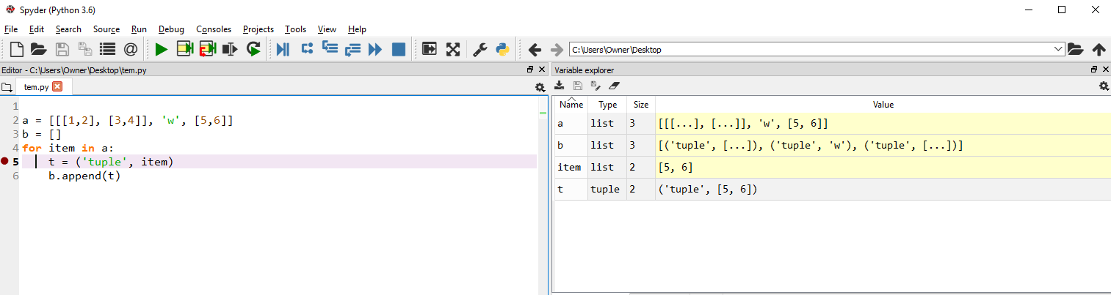
Breakpoints
Set Breakpoint:
- Double click on line number to insert
the debugger will stop only on the marked lines
Shows variable values each time it stops
Run until next breakpoint

Slide 31
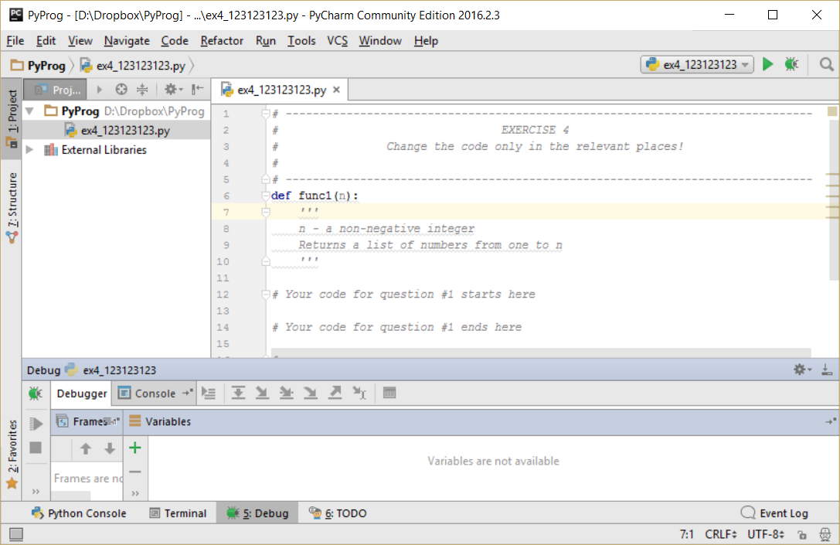
Debugging in PyChram
Run script (like F5 in idle)
Start debugging
Variable explorer
Console (like idle shell)
Script output

Slide 32
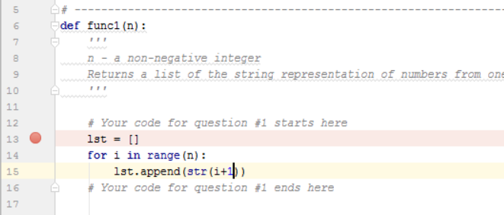
Breakpoints
Set Breakpoint:
Click next to the line number to insert a breakpoint
The debugger will start running and stop only on the marked lines
Shows variable values each time it stops

Slide 33
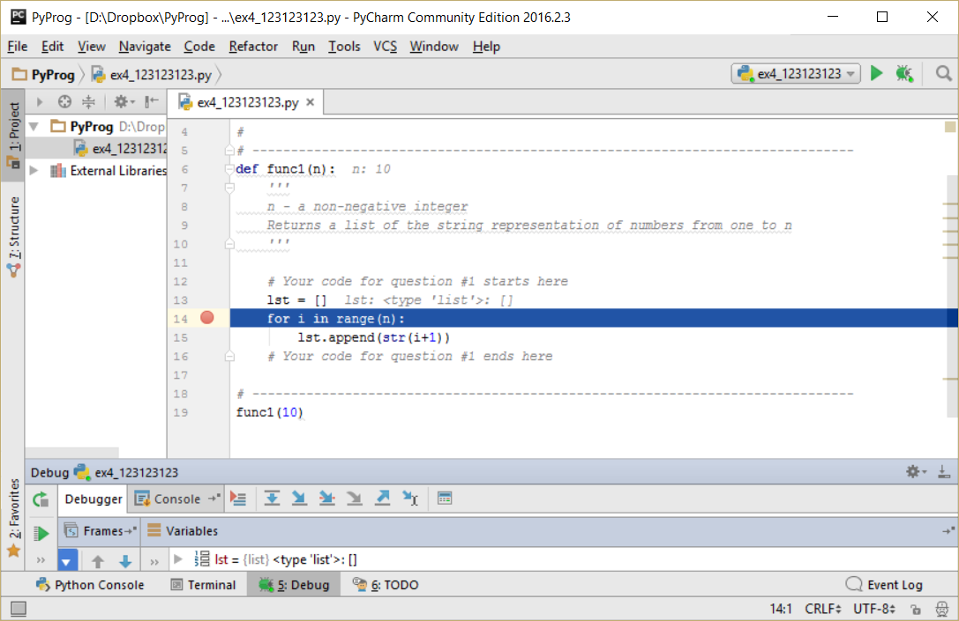
Stepping inside code
Click ‘debug’
Debugging keys:
Alt + Shift + F9 start debug
F8 to step forward to the next line
F7 to step into a function
F9 to jump to the next breakpoint
The script will run until it reaches a breakpoint
Now you can see what the variables are set to at this point of your execution

Slide 34
Example 1
Mission: replace first and last character in a string
def switch(s):
first = s[0]
last = s[-1]
s = s.replace(s[0], last )
s = s.replace(s[-1], first )
return s
>>> switch('abcd')
abca
>>> switch('banana')
bbnbnb

Slide 35
Example 1
Add print
def switch(s):
first = s [0]
last = s [-1]
print(s)
s = s.replace(s[0], last )
print(s)
s = s.replace(s[-1], first )
return s

Slide 36
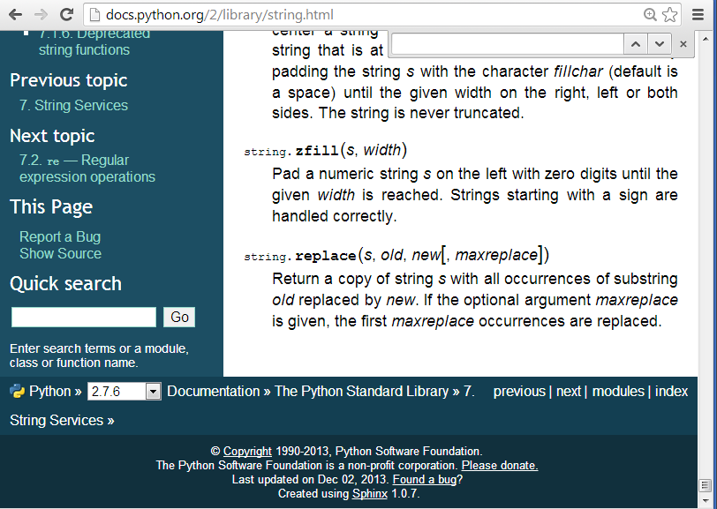
Example 1
>>> switch('abcd')
abcd
dbcd
'abca'
>>> switch('banana')
banana
aanana
'bbnbnb'
Observations?
Search what replace does!!!

Slide 37
Example 1
Observation:
replace changes all occurrences of the character in the string – we only want one specific change.
>>> help(str.replace)
replace(...)
S.replace(old, new[, count]) -> str
Solution?
s = s.replace(s[0], last, 1)
s = s.replace(s[-1], first, 1)

Slide 38
Example 1
>>> switch('abcd')
abcd
dbcd
'abcd'
>>> switch('banana')
banana
aanana
'banana’
Observation: The first letter is changed twice: forth and back!
Solution: replace doesn’t work for us, use a different method!

Slide 39


Example 1
New code:
return s[-1] + s[1:-1] + s[0]
>>> switch('abcd')
'dbca'
>>> switch('banana')
'aananb'

Slide 40
Example 2
Mission: create 1000 lists of 25 guesses (random numbers) from 0,1,2,3
import random
n_suits, n_cards, n_players = 4, 25, 1000
players_guess = [ ]
cards_list = [0] * n_cards
# create guesses
for player in range(n_players):
for card in range(n_cards): # create one guess
cards_list[card] = random.randrange(0, n_suits)
players_guess.append(cards_list)

Slide 41

Example 2
Investigate the lists created:
>>> players_guess[0]
[1, 1, 3, 3, 2, 2, 2, 3, 1, 2, 3, 1, 3, 0, 0, 3, 2, 0, 2, 0, 3, 2, 2, 3, 2]
>>> players_guess[1]
[1, 1, 3, 3, 2, 2, 2, 3, 1, 2, 3, 1, 3, 0, 0, 3, 2, 0, 2, 0, 3, 2, 2, 3, 2]
>>> players_guess[2]
[1, 1, 3, 3, 2, 2, 2, 3, 1, 2, 3, 1, 3, 0, 0, 3, 2, 0, 2, 0, 3, 2, 2, 3, 2]
Oh no, a bug!

Slide 42
Example 2
Trace the code step by step.
In this case – by iterations.
We begin by tracing the outer loop:
for player in range(3): # 1000 is a lot!
for card in range(n_cards):
cards_list[card] = random.randrange(0, n_suits)
players_guess.append(cards_list)
print(cards_list)

Slide 43

Example 2
Output of cards_list in each iteration:
[2, 3, 3, 0, 2, 1, 2, 0, 2, 3, 2, 2, 2, 1, 1, 0, 0, 2, 2, 1, 2, 3, 0, 0, 3]
[1, 2, 3, 3, 2, 0, 0, 1, 0, 0, 1, 2, 2, 3, 3, 1, 2, 1, 0, 0, 2, 0, 1, 3, 3]
[2, 2, 2, 0, 3, 1, 3, 2, 1, 2, 3, 1, 2, 3, 1, 2, 1, 1, 0, 1, 2, 2, 0, 2, 1]
The problem is not here.
What is players_guess?
>>> players_guess
[[2, 2, 2, 0, 3, 1, 3, 2, 1, 2, 3, 1, 2, 3, 1, 2, 1, 1, 0, 1, 2, 2, 0, 2, 1]
, [2, 2, 2, 0, 3, 1, 3, 2, 1, 2, 3, 1, 2, 3, 1, 2, 1, 1, 0, 1, 2, 2, 0, 2, 1]
, [2, 2, 2, 0, 3, 1, 3, 2, 1, 2, 3, 1, 2, 3, 1, 2, 1, 1, 0, 1, 2, 2, 0, 2, 1]]
Notice anything?

Slide 44
Example 2
Ok, we found the problem, but what is the reason? And the solution?
Main suspect:
players_guess.append(cards_list)
Is this drawing correct?
cards_list
players_guess
cards_list
cards_list

Slide 45
Example 2
There is only one list – which is mutated in every iteration
Found the problem!
Solution?
cards_list
players_guess
cards_list
cards_list

Slide 46
Example 2 – corrected code
players_guess = [ ]
for player in range(n_players):
# create cards list inside the loop
cards_list = [0] * n_cards
for card in range(n_cards):
cards_list[card] = random.randrange(0, n_suits)
players_guess.append(cards_list)

Slide 47
Example 3
An anagram is a type of word play, the result of rearranging the letters of a word or phrase to produce a new word or phrase, using all the original letters exactly once.
Example:
cat – act
orchestra – carthorse
חמולה - לוחמה
Mission: write a function that receives as input two strings and returns True is they are anagrams and False otherwise.

Slide 48
Example 3
Solution: a histogram for each string, using a dictionary
Key – a letter
Value – the number of times the letter appears
Dictionaries that have the same key-value pairs represent anagrams
First function: histogram(string)
Second function: are_anagrams(a, b)

Slide 49
Example 3: tests before code
Guide: write commands that return\print True if the test is as expected.
# expected counts for a character print(histogram("bamba").get('b', 0) == 2) print(histogram("bamba").get('b', 0) != 3) print(histogram("bamba").get('m', 0) > 0) print(histogram("").get('b', 0) == 0)
# expected dictionary properties print(len(histogram("").keys()) == 0) print(len(histogram("aaabbb").keys()) == 2) print(sum(histogram("aaabbb").values()) == 6)

Slide 50
Example 3: tests before code
print(are_anagrams("cat", "act") == True) # test if order matters print(are_anagrams("act", "cat") == True) print(are_anagrams("rem", "act") == False) # test if the function can deal with empty strings print(are_anagrams("", "act") == False) print(are_anagrams("orchestra", "carthorse") == True)

Slide 51
Example 3: the code
def histogram(string):
d = { }
for char in string:
count = d.get(char,0)
d[char] = count + 1
return d

Slide 52
Example 3: the code
def are_anagrams(s1,s2):
if len(s1) != len(s2):
return False
d1 = histogram(s1)
d2 = histogram(s2)
# Dictionaries are equal if and only if
# their sorted (key, value) lists are equal
return d1 == d2
Now, let’s use the debugger!

Slide 53
Advanced Example: Spell Corrector
In computing, a spell corrector is an application that corrects words that are misspelled.
Input to construct the basic spell corrector:
A set of known words, which may appear in texts.
A set of “potential errors”.
Goal: implement a basic spell corrector, which receives as input some text, and returns it corrected.

Slide 54
Spell corrector: Potential errors
A potential error is a tuple pair of letters (letter1, letter2)
It represents that letter1 might be accidently replaced by letter2.
We assume that in any given text, each word has 0 or 1 errors, no more.
For instance, given the potential error ("e", "r"):
The following error may occur in the word "pet" :
pet -> prt
and the following in the word "example":
example -> examplr
example -> rxample

Slide 55
Seems complex but…
What do we basically need here?
A dictionary, which maps words with 0 or 1 errors to their correct forms.
Remember: modular programming
Top-down approach: first write what you plan to do and then implement the details
Break the problem to functions
But how do we break this mission to functions?

Slide 56
Spell corrector: Functions
There are several ways (we suggest the following):
Initialize a dictionary.
First, add all words without errors.
For each known word and each error:
Generate all possible pairs: (word_with_1_error, word).
Add the pairs to the dictionary.
Answer queries:
Given a text, return it corrected, using the pre-built dictionary.

Slide 57
Spell corrector: 1. Initialize dictionary
Input: a list of words
Output: a new dictionary with pairs word:word.
def init_dict(known_words):
dic = {}
for word in known_words:
dic[word] = word
return dic
>>> known_words = ['here','we','are','in','the','center','of','town'] >>> dic = init_dict(known_words) >>> dic {'town': 'town', 'we': 'we', 'center': 'center', 'of': 'of', 'here': 'here', 'are': 'are', 'in': 'in', 'the': 'the'}

Slide 58
Spell corrector: 2. All Errors of a Known Word
Input: (1) a known word, (2) a potential error = (letter1, letter2)
Output: a list of pairs, each representing one change of letter1 to letter2 in the known word.
def spelling_errors(word, error):
pairs = []
for i in range(len(word)):
if word[i] == error[0]: # If letter1 found
# Change to letter2.
bad_word = word[0:i]+error[1]+word[i+1:]
subtitution = (bad_word, word) pairs.append(subtitution) return pairs
>>> spelling_errors( 'here', ('e', 'w') ) [('hwre', 'here'), ('herw', 'here')] >>> spelling_errors( 'here', ('e', 'r') ) [('hrre', 'here'), ('herr', 'here')]

Slide 59
Spell corrector: 3. Add all Possible Corrections
Input: (1) initialized dictionary, (2) list of potential errors.
Output: the dictionary, having added all possible bad_word:good_word pairs, according to the errors.
We cannot iterate over dict.keys() view, and during the iteration add elements to the dictionary. Thus we create a list of current keys in the dictionary
def add_corrections(spell_check_dict, errors):
for word in list(spell_check_dict.keys()):
for error in errors:
corrections = spelling_errors(word, error)
spell_check_dict.update(corrections)
>>> errors = [('e','r'),('e','w'),('a','s'),('o','p')] >>> add_corrections(dic, errors) >>> dic {'arr': 'are', 'arw': 'are', 'crnter': 'center', 'are': 'are', 'in': 'in', 'cwnter': 'center', 'centwr': 'center', 'pf': 'of', 'hwre': 'here', 'we': 'we', 'here': 'here', 'centrr': 'center', 'wr': 'we', 'herr': 'here', 'herw': 'here', 'hrre': 'here', 'town': 'town', 'ww': 'we', 'center': 'center', 'sre': 'are', 'thw': 'the', 'of': 'of', 'thr': 'the', 'tpwn': 'town', 'the': 'the'}

Slide 60
Finally: Correct Any Text
Input: (1) text string, (2) pre-built dictionary.
Output: the corrected text.
def correct_spelling(text, dic):
corrected_words = []
for word in text.split() :
corrected_words.append(dic[word])
return ' '.join(corrected_words)

Slide 61
Spell corrector: Run Example
>>> known_words = ['the', 'in', 'of', 'center', 'we', 'here', 'are', 'town'] >>> errors = [('e','r'), ('e','w'), ('a','s'), ('o','p')]
>>> dic = init_dict(known_words) >>> add_corrections(dic, errors)
>>> text = 'hwre ww sre in thr centrr pf tpwn'
>>> print(correct_spelling(text, dic))
'here we are in the center of town'
What happens if a misspelled word does not appear in known_words / the relevant error is missing ?
What happens if a word appears in known_words and could also result from a spelling error ?

